Slide 1
Cryptography Assignment
Huang Wen
Sherwyn
Ernest
Keiran

Slide 2
Table of Content
01
04
02
05
03
06
Introduction
Purposes
Characteristics
Strengths and Weaknesses
Detail Operations
Relevant Information

Slide 3
Morse Code
Introduction

Slide 4
What is Morse Code?
Dots and dashes, aka dits and dahs, represent text characters in communications.
Created by Samuel Morse and is named after him.
International Morse Code is created based of his version.

Slide 5
Characteristics
02

Slide 6
What is Unique
Encodes A - Z, 0 – 9, and punctuation as dits and dahs
Dit is the fundamental unit of time
1 dah = 3 dit
Can be transmitted through various mediums

Slide 7
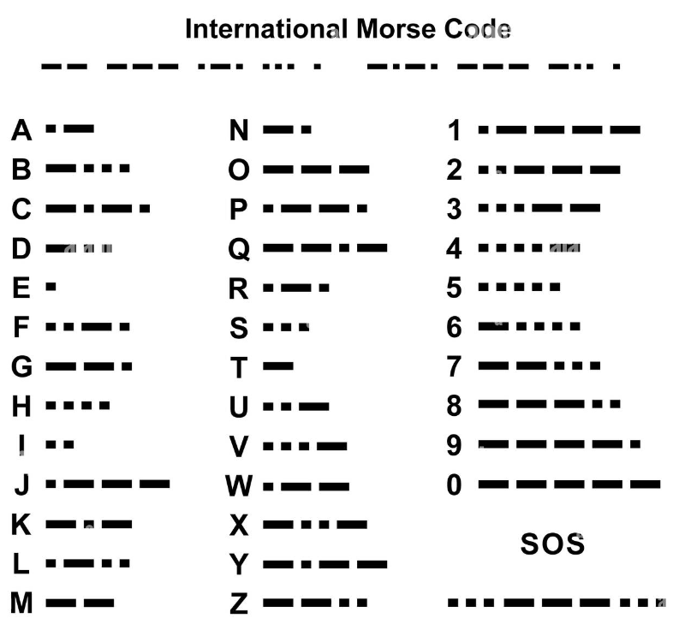
Key Sheet

Slide 8
Detail Operations

Slide 9
How it Works
User turns each letter, number and punctuation in a sequence of dits and dahs according to the international morse code key sheet.
The receiver receiving the encoded message decrypts it using the key sheet to get the message.

Slide 10
Purposes

Slide 11
What is it Used For
Radio operation
Another form of communication
Used in WW2
Used in aviation and marine
Help the disabled to communicate

Slide 12
Strengths and weaknesses

Slide 13
Strengths
Simple and inexpensive
Wide variety of transmission mediums
Easy to encrypt and decrypt
Recommended to use for emergencies

Slide 14
Weaknesses
Requires practice to master it
Tedious to encrypt and decrypt long messages
Easily deciphered using statistical properties
Unique key sheets need to be transferred over secure channels

Slide 15
RC4
Introduction

Slide 16
What is RC4?
Invented by Rion Rivest in 1987
Rivest Cipher 4 (RC4) is a stream cipher
Frequently employed

Slide 17
Characteristics
02

Slide 18
Specialty
Uses a symmetric key encryption
Uses 2 key mathematical algorithms:
- KSA (Key Scheduling Algorithm)
- PRGA (Pseudo-Random Generation)

Slide 19
Detail Operations

Slide 20
Detail Operations (Part 1)
User enters plaintext and a secret key
Encryption engine would then use an S array of length 256 where S[ 0 ] = 0 and S[ 255 ] = 255
The key entered would then be encoded using the ASCII table.
Key: HI W
Encoded with ASCII table: 72 73 32 87

Slide 21
Part 2
The encoded key is then repeated to fill the key array of length 256
K[ 0 ] = 72
K[ 3 ] = 87
K[ 7 ] = 87
Key scheduling – to get the key
J = 0
For i = 0 to 255 carry out
J = J + S[ i ] +T[ i ] mod (256)
Swap S[ i ] and S[ J ]

Slide 22
Part 3 - KSA
Key: 1 2 3 4
S-Array length: 8
S-Array: [ 0 1 2 3 4 5 6 7 ]
Key-array = [ 1 2 3 4 1 2 3 4 ]
Plaintext: 1 3 4 5
J = 0
For i = 0 to 7, carry out
J=J+ S[ i ] + K[ i ] mod (8)
Swap S[ i ] and S[ J ]

Slide 23
Part 4 - KSA
First Iteration:
When i = 0,
J = 0+S[ 0 ] + K[ 0 ] mod (8)
J = 0 + 0 + 1 mod (8)
J = 1
Swap S[ 0 ] and S[ 1 ]
S-Array = [ 1 0 2 3 4 5 6 7 ]

Slide 24
Part 5 - KSA
Second Iteration:
When i = 1,
J = 1 + 0 + 2 mod (8)
J = 3
Swap S[ 1 ] and S[ 3 ]
S-Array = [ 1 0 2 3 4 5 6 7 ] (before)
S-Array=[ 1 3 2 0 4 5 6 7 ]

Slide 25
Part 6 - KSA
Third Iteration:
When i = 2,
J = 3 + 2 + 3 mod (8)
J = 0
Swap S[ 2 ] and S[ 0 ]
S-Array=[ 1 3 2 0 4 5 6 7 ] (before)
S-Array = [ 2 3 1 0 4 5 6 7 ]

Slide 26
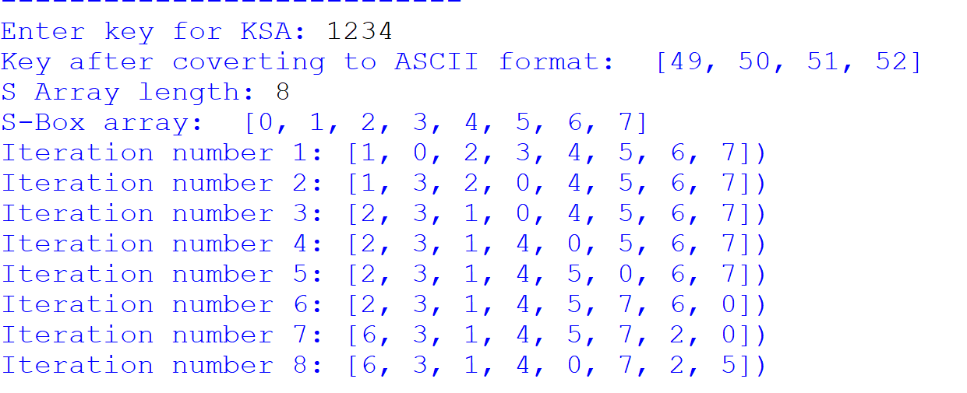
And So On…

Slide 27
Pseudo-Random generation
I = J = 0
For I = I + 1 to the length of the plaintext
J = J + S[I] mod 256
Swap S[I] and S[J]
T= S[I] +S[J] mod256
Keystream = S[T]
using S-Array = [ 2 3 1 0 4 5 6 7]

Slide 28
Pseudo random generation
When I =1
J=J+S[1]mod8
J=0+3
J=3
Swap S[1] and S[3]
S-Array = [ 2 0 1 3 4 5 6 7 ]
T=S[1] + S[3]mod8
T= 0 + 3
T=3
Keystream = S[3]
Keystream = 3
When I =2
J = 3 + 1 mod 8
J = 4
Swap S[2] and S[4]
S-Array = [ 2 0 4 3 1 5 6 7 ]
T= 4+1
T = 5
Keystream = S[5]
Keystream = 5

Slide 29
Pseudo random generation
When I = 3
J = 4 + 3 mod 8
J = 7
Swap S[3] and S[7]
S-array = [ 2 0 4 7 1 5 6 3]
T = 7 + 3 mod 8
T = 2
Keystream = S[2]
Keystream = 4

Slide 30
Purposes

Slide 31
Its Uses
A proprietary algorithm for RSA
Faster and require less resources
Maintains legacy system
Notes:
Invented as a proprietary algorithm for RSA.
Faster and require less computational resources compared to other encryption algorithm at that time.
Today, it is used to maintain legacy systems which still uses it.

Slide 32
Strengths and Weaknesses

Slide 33
Strengths
Extremely simple to use
Simple implementation
Fast
Works with large streams of data swiftly and easily
Do not require any additional memory
Notes:
RC4 is extremely simple to use, thus making the implementation simple as well.
RC4 is fast, due to its simplicity, which makes it a better performing cipher
RC4 also works with large streams of data swiftly and easily.
RC4 stream ciphers do not require any additional memory.

Slide 34
Weaknesses
Allows remote attackers to exploit vulnerabilities found
Cannot be used on smaller streams of data
Does not have authentication
Cannot use the same key
Need a secure channel to send the key
Decoded easily if the key and the ciphertext are leaked
Notes:
Could allow remote attackers to exploit vulnerabilities found, to obtain private information, making it extremely insecure and irrelevant.
Cannot be used on smaller stream of data, more niche.
RC4 does not require authentication, hence it is vulnerable to attacks such as man in the middle attack.

Slide 35
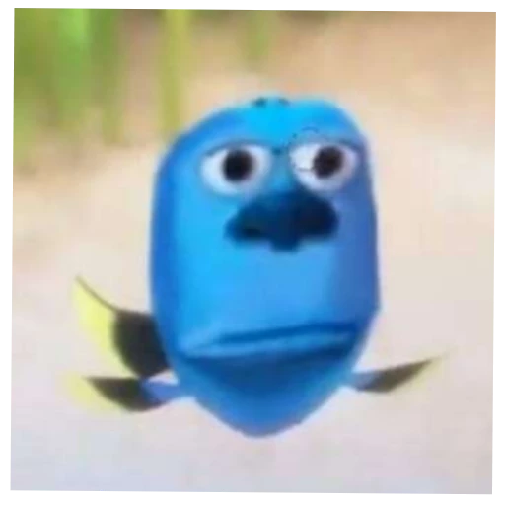
Thank You

